Slide 1
A Cost-Effective Deadline-Constrained Dynamic Scheduling Algorithm for Scientific Workflows in a Cloud Environment
Jyoti Sahni and Deo Prakash Vidyarthi
IEEE Transactions on Cloud Computing, Vol. 6, no. 1, pp. 2- 18, Jan.- March, 1, 2018
Presenter: Chih-Hsuan Chien​
Date: July 26, 2022

Slide 2
Abstract (1/2)
Cloud computing, a distributed computing paradigm, enables delivery of IT resources over the Internet and follows the pay-as-you-go billing model. Workflow scheduling is one of the most challenging problems in cloud computing. Although, workflow scheduling on distributed systems like grids and clusters have been extensively studied, however, these solutions are not viable for a cloud environment. It is because, a cloud environment differs from other distributed environment in two major ways: on-demand resource provisioning and pay-as-you-go pricing model. Thus, to achieve the true benefits of workflow orchestration onto cloud resources novel approaches that can capitalize the advantages and address the challenges specific to a cloud environment needs to be developed.
Notes:
Paradigm 示範
Viable 可行的
Orchestration 編排

Slide 3
Abstract (2/2)
This work proposes a dynamic cost-effective deadline-constrained heuristic algorithm for scheduling a scientific workflow in a public cloud. The proposed technique aims to exploit the advantages offered by cloud computing while taking into account the virtual machine (VM) performance variability and instance acquisition delay to identify a just-in-time schedule of a deadline constrained scientific workflow at lesser costs. Performance evaluation on some well-known scientific workflows exhibit that the proposed algorithm delivers better performance in comparison to the current state-of-the-art heuristics.

Slide 4
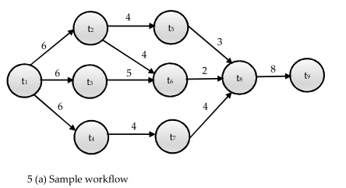
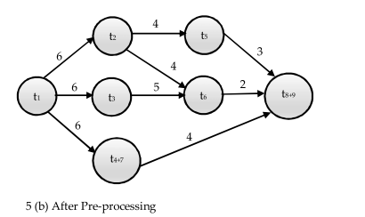
Preprocess

Slide 5
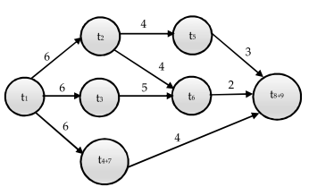
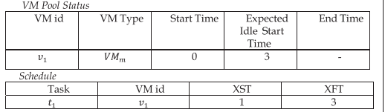
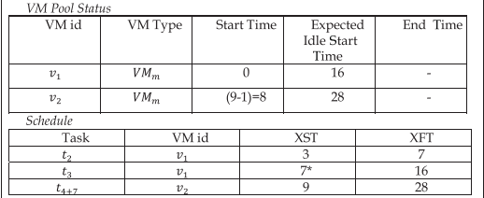
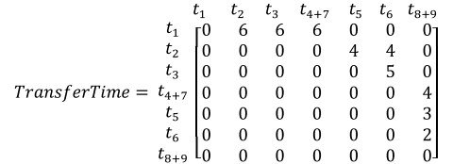
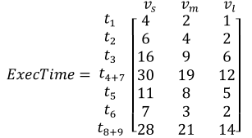
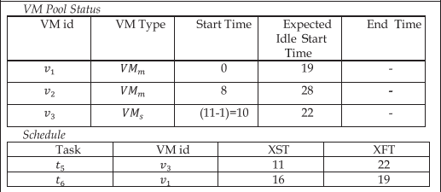
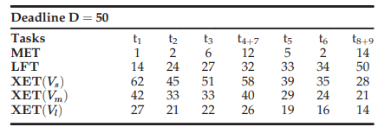
VM boottime=1

Slide 6
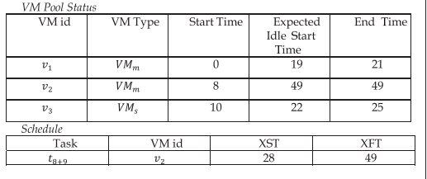
$ 0.02* 3+ $ 0.02*5+ $ 0.01*2= $ 0.18

Slide 7
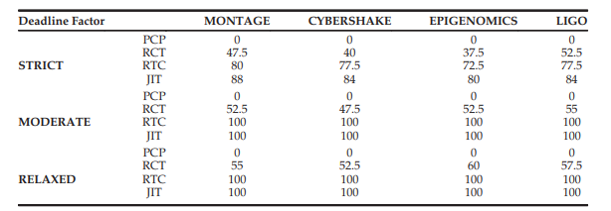
Experiment
Notes:
Pcp沒有考慮到效能的變動所以都沒達到deadline
Rct和rtc將一些time加到pcp deadline裡

Slide 8
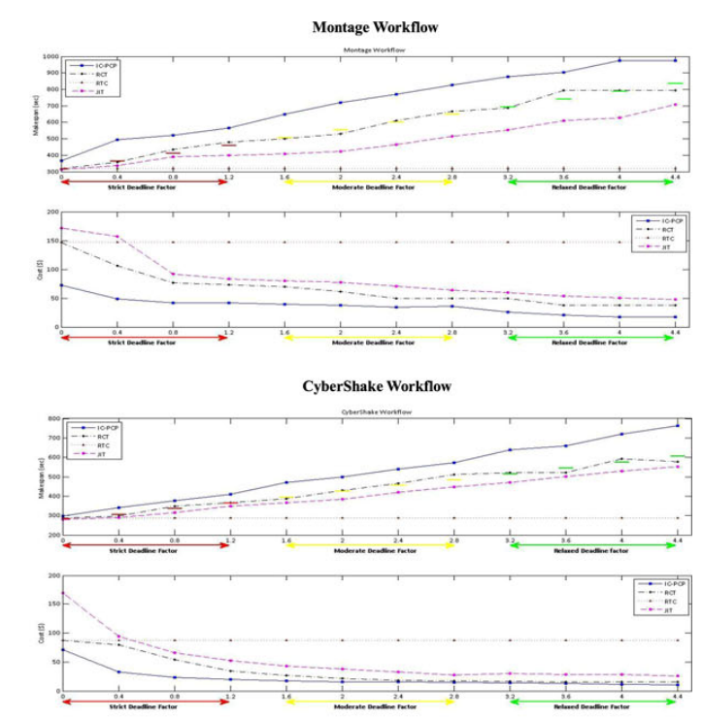
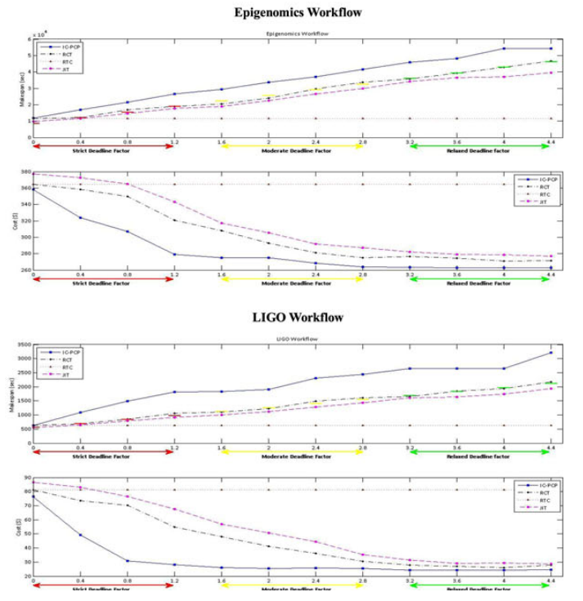
Notes:
Ic-pcp因為都沒達到deadline 所以她的cost都是最高的

